Slide 1



購物年金打造超連鎖™事業
Growing UnFranchise™ Business with fully utilizing Shopping Annuity
Nora Siu
高級顧問經理級
Director
四個佣金週期共賺取HK$138,000*
HK$138,000 in 4 Commission weeks
*本簡報中提到的收入等級純屬舉例說明，無意代表美安香港超連鎖™店主的一般收入，也無意表示任何超連鎖™店主皆可賺取同等收入。美安香港超連鎖™店主的成功與否，取決於其在發展事業時的努力、才能與投入程度。The income levels mentioned in the following presentation are for illustration purposes only. They are not intended to represent the income of a typical Market Hong Kong UnFranchise ™Owner, nor are they intended to represent that any given Independent UnFranchise ™ Owner will earn income in that amount. The success of any Market Hong Kong Independent UnFranchise ™ Owner will depend upon the amount of hard work, talent, and dedication which he or she devotes to building his or her Market Hong Kong Business.

Slide 2


購物年金
Shopping Annuity
打造超連鎖™事業
Grow your Unfranchise™ business
Notes:
TRAINERS NOTES:
Welcome guests. Let them know that why you’re excited to be sharing this revolutionary concept with them.
It gives everyone a chance to enjoy the benefits of annuity without having to fund it with discretionary income, but rather with money they are already spending
We are going to show you how you could create a residual income for yourself by simply changing how you shop and duplicating it with your team
This plan is essentially rocket fuel for the MPCP.
Share any of your personal success or team’s success with the Shopping Annuity

Slide 3

成功
System of
的系統
Success
Notes:
TRAINERS NOTES:
Like with a franchise, we have a proven system for success. You don’t need to go through trial and error to make this work. All you have to do is understand the concepts and implement the system.

Slide 4

在今天的銀行匯率下，你有這麼多現金作出投資嗎？Will you have this cash invested in the bank at today’s rates ?
超連鎖™永續收入UnFranchise™ Ongoing Income | 4%的投資法則 The 4% Rule Investment
$4,600 / 月month (經理級/ 主管經理級) (EC/ MC) | $1,380,000
$34,500 / 月month (專業經理級)(PC) | $11,040,000
$76,600 / 月month (總顧問經理級)(NSC) | $24,512,000
$138,000 / 月month (高級顧問經理級)(Director) | $44,850,000
$276,000 / 月month ( 副總裁級)(FVP) | $92,000,000
超連鎖™收入
UnFranchise™ Income
vs.
4%的投資法則
The 4% Rule Investment
Notes:
TRAINERS NOTES:
The 4% Rule is a popular investment-income strategy that says as long as you withdraw no more than 4% of your initial portfolio, adjusted for inflation, on an annual basis during your retirement years, you shouldn't run out of money.
Take a look at what it would take to create a $4,600/month payment to yourself at retirement, following this rule. It would take $450,000 in the bank! Would you have that money saved up by retirement?
Most Americans are living paycheck to paycheck with little to no savings. How will they get it done? The answer is that most won’t, and therefore will never have the 4% rule as a viable retirement option.
With Market America, you could create a $4,600 / month asset as an executive coordinator or master coordinator. And even more, after 2-3 years of following our proven plan you could create a residual income of $1,420,000 / year. That is the equivalent of living off of 4% of a $5MILLION asset in the bank!
Think even further – if you built the UnFranchise as a way to enjoy residual income because you didn’t have the savings to participate in the 4% rule, now you can create the savings and earn both – the Residual Income from your UnFranchise and the 4% off the income you save!

Slide 5

甚麼是年金
What is an Annuity
「年金」年金是指你在等額、定期的
系列收支。
建立「年金」時，你必須在有收支前先投入一筆固定的資金。
An “Annuity” is a process by which a fixed payment is made to you at specified intervals for a specified length of time.
To fund the “Annuity” you must contribute a fixed sum payment before payouts to you may begin.
Notes:
TRAINERS NOTES:
Again, this is a popular investment and/or retirement strategy.
The benefit is that by paying into your annuity over time, you can expect to be paid back payments at retirement in monthly, quarterly, yearly or even lump sum payments based on your specific arrangements.
The downfall is that in order to fund the annuity, you need discretionary income to pay into it with. Most Americans have little to no discretionary income, therefore, cannot participate in an annuity program as part of their retirement strategy.

Slide 6


資產
Willable Asset
你每星期可賺取HK$11,500-27,600
You can reasonably expect to earn $11,500 - $27,600 /
week in perpetuity
你可以把你的資產留給你的家庭和後代
You can will this asset to family and generations to come.
Notes:
TRAINERS NOTES:
How can you keep your hard earned assets in the family?
Your UnFranchise is a willable asset and can be willed to family and generations to come.

Slide 7

你本身已不斷消費
何不將你的消費轉為收入﹖
You’re Already Spending It…
Why Not Convert Your Spending Into Earning?
Notes:
TRAINERS NOTES:
Again, we are hitting this point! You are not funding this Shopping Annuity with discretionary income, but with money you are already spending.
Everybody spends money to live. You can either find a way to make that money work for you or you can continue to do what you’re doing and everything stays the same.

Slide 8
入息與開支數據Income and Household Statistics
以下數據均來自政府統計處, 《二零零九至一零年住戶開支統計調查及重訂消費物價指數基期 》
http://www.statistics.gov.hk/pub/B10600082010XXXXB0100.pdf
The following is from the Census and Statistics Department (C&SD), 2009/10 Household Expenditure Survey
and the Rebasing of the Consumer Price Indices, based on consumer unit http://www.statistics.gov.hk/pub/B10600082010XXXXB0100.pdf
平均
消費數字:
AVERAGE CONSUMER
UNIT CHARACTERISTICS:
$586,491
$565,693
$259,476
未扣稅的收入
Income before taxes
扣稅後的收入
Income after taxes
平均全年總支出
Total Average Annual Expenditures
受訪者平均資料:
Average number in consumer unit:
住戶人數
People
18歲以下子女
Children under 18
65歲或以上成人
Adults 65 and older
賺取收入人數
Earners
汽車
Vehicles
男性
Men
女性
Women
3.0
0.48
0.45
1.6
0.21
46
54
Notes:
TRAINERS NOTES:
We’ve been saying that people are spending the money. All they need to do is convert it.
Now we are going to introduce statistical evidence which proves the point that the money IS being spent. One of the biggest mental/ thinking hurdles we need to overcome when presenting this is the idea that the money is being spent. Many people make their money and spend all (or almost all of it) yet still have a knee-jerk reaction and think they couldn’t find the dollars from their current spending to transfer over. The purpose of this upcoming section is to eliminate those concerns by showing hard data.
Don’t forget to note:
These stats are not UnFranchise Stats. They are from the Census and Statistics Department (C&SD), 2009/10 Household Expenditure Survey
and the Rebasing of the Consumer Price Indices. They are can be accessed by the public.

Slide 9
錢都花到哪裡去了﹖Where does the money go?
稍後，你將會有一個簡單的每月開支和平均開支比較。Later, you will go through a simple exercise to identify how your monthly spending compares to the average spending.
食物Food
可於SHOP.COM購買並建立購物年金的項目SHOPPING ANNUITY ITEMS PURCHASEABLE ON SHOP.COM
開支Consumer Units
小計Sub Total
住屋Housing
食品(不包括外出用膳)Food at home | 2244.5
米Rice | 713.6
其他穀類和穀類製品Other cereals and cereal preparations | 56.3
麵包及糕餅Bakery products | 171
雞蛋Eggs | 28
牛肉Beef | 48
豬肉Pork | 247
家禽Poultry | 87
魚類及海鮮Fish and seafood | 314
新鮮蔬菜Fresh vegetables | 251
新鮮水果Fresh fruit | 154
其他食品Other food at home | 175
外出用膳Food away from home | 3691
酒類與煙草Alcoholic drinks and tobacco | 126
服裝與服務Apparel & Service
交通Transportation
健康護理Healthcare
6062
娛樂Entertainment
個人護理產品及服務Personal Care Product & Service
閱讀Reading
雜項MISCELLANEOUS
Notes:
Celine:
We need more time to localize slides 13-18 as we are waiting for latest figures from government sources.
Penelope:
The latest figures are from the Census and Statistics Department (C&SD), Monthly Report on
the Consumer Price Index(February 2015) http://www.statistics.gov.hk/pub/B10600012015MM02B0100.pdf
TRAINERS NOTES:
For the purpose of this demonstration, we are only going to highlight the stats on spending that could be transferred over to your Shopping Annuity.
The first of four slides, we begin by showing the money that is being spent on food. Again, we are only showing you categories that could be transferred to SHOP.COM. Notice how we only show processed fruits and vegetables and not fresh fruits and vegetables. Until we get a partner store that would fill that need, we won’t calculate fresh fruits and vegetables into our potential spending for our Shopping Annuity.
This is showing the average ANNUAL SPENDING on Food items – ask yourself – how do you think your spending compares to this?
For the food category, you probably purchase a lot of these items on a regular monthly basis. If you could plan ahead, you could convert that inevitable spending into earning.

Slide 10
錢都花到哪裡去了﹖Where does the money go?
稍後，你將會有一個簡單的每月開支和平均開支比較。Later, you will go through a simple exercise to identify how your monthly spending compares to the average spending.
食物Food
可於SHOP.COM購買並建立購物年金的項目SHOPPING ANNUITY ITEMS PURCHASEABLE ON SHOP.COM
開支Consumer Units
小計Sub Total
住屋Housing
保養住所材料Materials for house maintenance | 130
電話及其他通訊設備Residential phone service, VOIP, and phone cards | 519
其他住屋開支Other household expenses | 454
家居清潔用具及用品Laundry and cleaning supplies | 39
其他家居用品Other household products | 61
家用紡織品Household textiles | 41
大型家電Major appliances | 171
小型家電, 其他家居用品Small appliances, miscellaneous housewares | 17
其他家用設備Miscellaneous household equipment | 61
服裝與服務Apparel & Service
交通Transportation
健康護理Healthcare
1,493
娛樂Entertainment
個人護理產品及服務Personal Care Product & Service
閱讀Reading
雜項MISCELLANEOUS
Notes:
Celine:
We need more time to localize slides 13-18 as we are waiting for latest figures from government sources.
TRAINERS NOTES:
Next, we take a closer look at the average spending on household expenses.
Highlight the items purchasable on SHOP.COM
Do you purchase items in these categories?
How often do you think you purchase these item?
Some of these items may be purchased on a regular monthly basis, while others may be purchased seasonally, annually or “as needed”.

Slide 11
錢都花到哪裡去了﹖Where does the money go?
稍後，你將會有一個簡單的每月開支和平均開支比較。Later, you will go through a simple exercise to identify how your monthly spending compares to the average spending.
食物Food
可於SHOP.COM購買並建立購物年金的項目SHOPPING ANNUITY ITEMS PURCHASEABLE ON SHOP.COM
開支Consumer Units
小計Sub Total
住屋Housing
服裝與服務APPAREL AND SERVICES
3,432
3,432
服裝與服務Apparel & Service
交通Transportation
購買的和修理汽車
Purchases of and repairs to motor vehicles
80
80
健康護理Healthcare
藥物Drugs
119
712
娛樂Entertainment
醫療Medical Services
593
個人護理產品及服務Personal Care Product & Service
閱讀Reading
雜項MISCELLANEOUS
Notes:
Celine:
We need more time to localize slides 13-18 as we are waiting for latest figures from government sources.
TRAINERS NOTES:
Next we talk about Apparel, transportation and health care.
Where are purchasing your clothes and shoes?
What about Tylenol or other drugs?
Where do you book your travel or airline tickets?
Again, so much of what you are buying could be transferred to SHOP.COM to earn you money! No need to purchase anything you don’t need – just change your habits and continuing buying everything you need, FROM YOURSELF

Slide 12
錢都花到哪裡去了﹖Where does the money go?
稍後，你將會有一個簡單的每月開支和平均開支比較。Later, you will go through a simple exercise to identify how your monthly spending compares to the average spending.
食物Food
可於SHOP.COM購買並建立購物年金的項目SHOPPING ANNUITY ITEMS PURCHASEABLE ON SHOP.COM
開支Consumer Units
小計Sub Total
住屋Housing
電影娛樂Cinema entertainment | 45
旅遊Package tours | 530
玩具及嗜好Toys and hobbies | 95
其他娛樂及假期開支Other entertainment and holiday expenses | 50
服裝與服務Apparel & Service
交通Transportation
720
健康護理Healthcare
娛樂Entertainment
個人護理產品及服務Personal Care Product & Service
個人護理產品及服務
Personal care products & services
330
330
閱讀Reading
117
117
個人護理產品及服務reading
雜項MISCELLANEOUS
雜項物品及服務
MISCELLANEOUS GOODS and SERVICES
1641
1641
Notes:
Celine:
We need more time to localize slides 13-18 as we are waiting for latest figures from government sources.
TRAINERS NOTES:
Entertainment – before going to the movies, check out your website. Find every possible bit of spending that could be paying you and start transferring it over.

Slide 13
你的每月開支與每月平均開支比較，結果如何？How does your monthly spending compare to the average monthly spending?
稍後，你將會有一個簡單的每月開支和平均開支比較。Later, you will go through a simple exercise to identify how your monthly spending compares to the average spending.
食物Food
住屋Housing
服裝與服務Apparel & Service
全年開支Annual Total
$175,044
交通Transportation
健康護理Healthcare
娛樂Entertainment
每月開支Monthly Total
個人護理產品及服務Personal Care Product & Service
$14,587
閱讀Reading
雜項MISCELLANEOUS
Notes:
Celine:
We need more time to localize slides 13-18 as we are waiting for latest figures from government sources.
TRAINERS NOTES:
There are little pockets of spending everywhere that could be transferred to your Shopping Annuity. You just have to be aware of where your money is going and make a conscious decision to transfer it.
Your business is currently LEAKING MONEY everywhere. You have the opportunity to take all of this money, which statistically you are going to spend anyway and turn that spending into a residual income for yourself.
Ask yourself, how much are you missing out on? If your team is only doing 10% of their shopping on their SHOP.COM website, it’s like taking a pallet of thousands of dollars and just setting it on fire. Money wasted!
Don’t waste or underestimate the power of your current spending. Put that money to work for you and use it to build your Shopping Annuity.

Slide 14
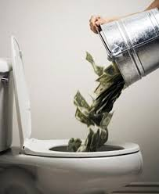
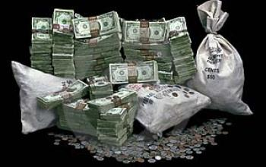
使錢
投資
轉
Convert Spending into Investing

Slide 15


如何投資你的購物年金﹖
How Do You Fund Your Shopping Annuity?
由改變你的
It Begins by
Adjusting Your
購物習慣Shopping
Behaviors
開始
Notes:
TRAINERS NOTES:
Do you agree that you are spending the money anyway?
Can you see all of the places where you could be earning?
Before you can implement our system for success, you have to acknowledge the change of shopping habits.

Slide 16


Notes:
TRAINERS NOTES:
It’s not just about our exclusive brands, we provide a better way to shop.
This is a transitional slide that will highlight some of the most exciting parts of SHOP.COM

Slide 17




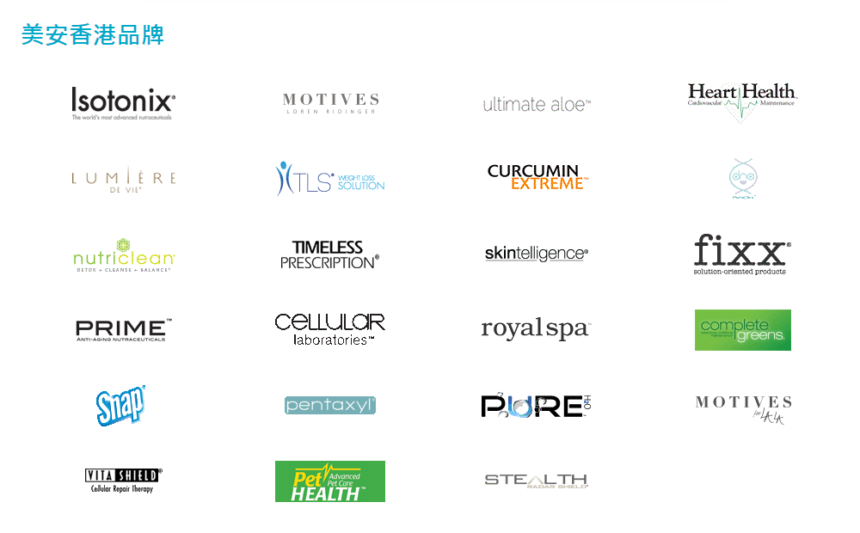

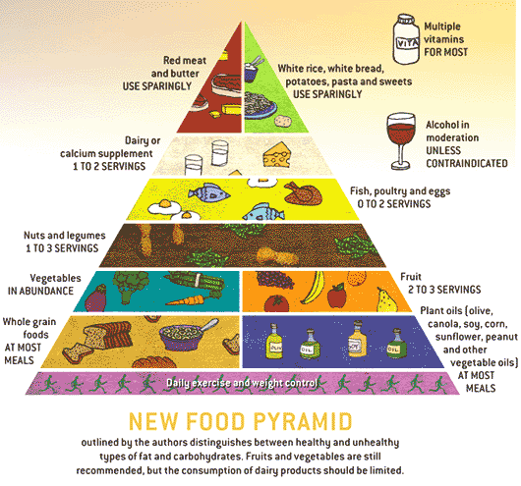



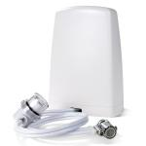

Slide 18


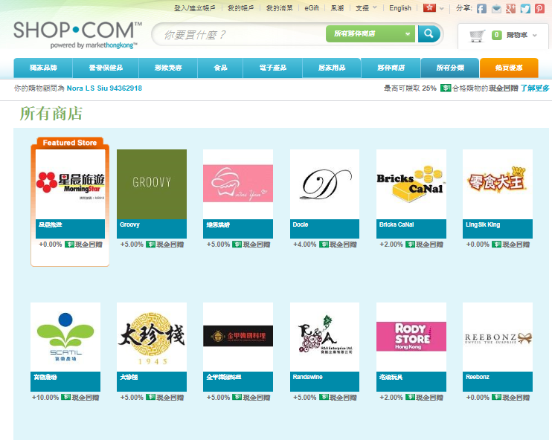
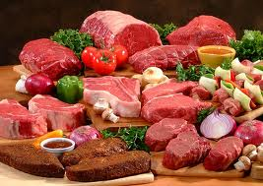
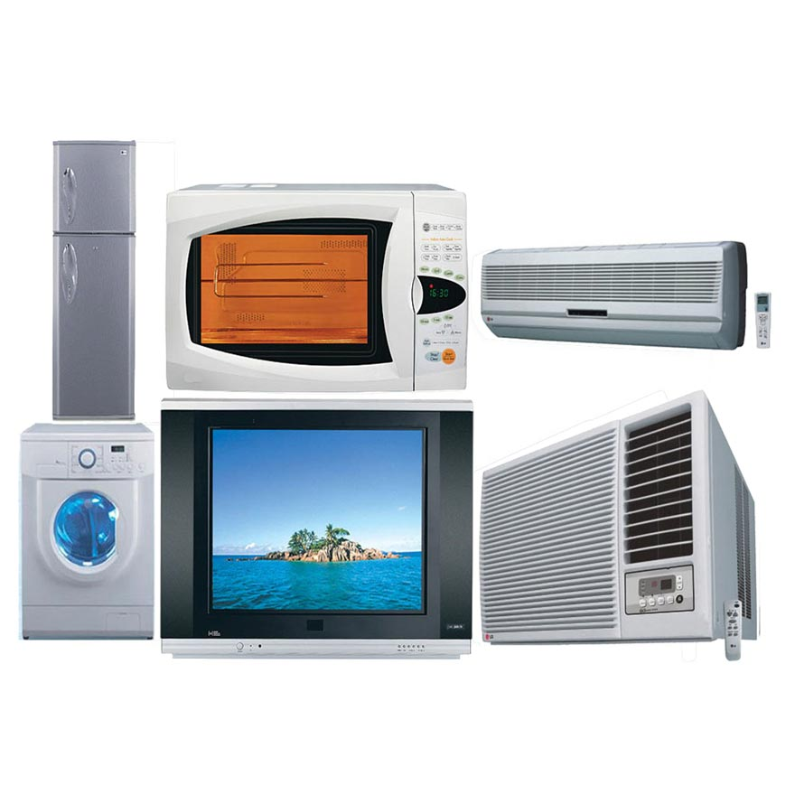

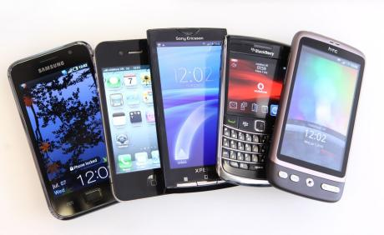


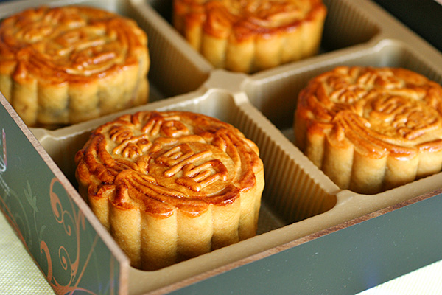


Slide 19
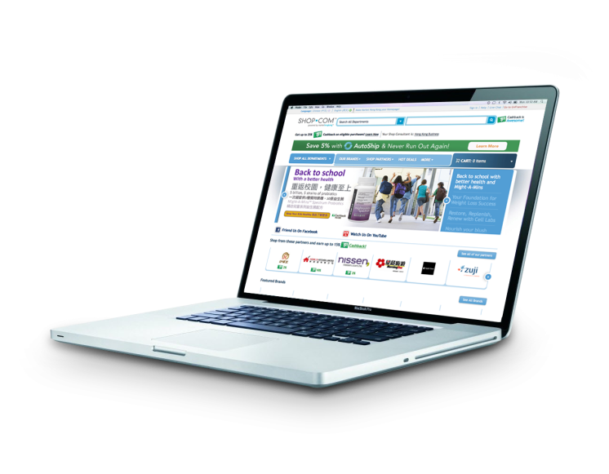






Hk.shop.com/yourshop

Slide 20

你選擇做那個角色?
Which role do you prefer?
1. 優惠顧客 Preferred Customer
用電郵就可登記 Registration with email
免費有 ‘VIP’顧客卡 FREE VIP Card
網上下消費有 2% - 25%現金回贈($)
On/off-line shopping with 2% - 25%Cashback
累積至 HK$80以上可入回銀行户口
Save in your bank account when reaching
the minimum redemption requirement of HKD$80
亦可當現金買產品 Apply the amount at checkout

Slide 21

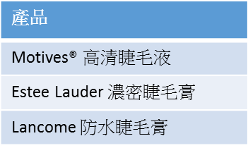
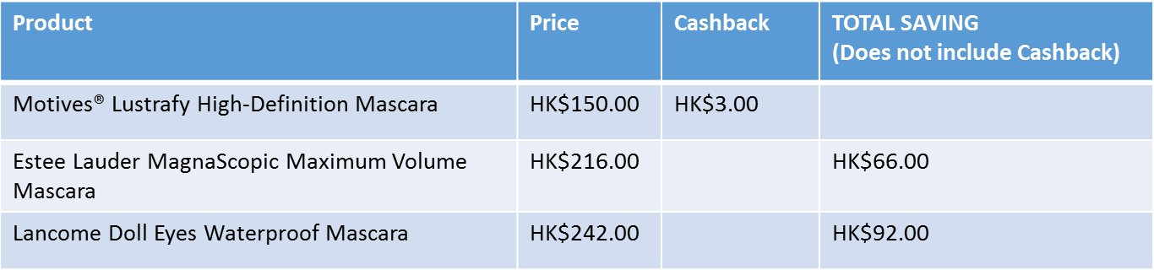
現金回贈
節省
價錢
Better Product, Better Price
Notes:
TRAINERS NOTES:
How many people in the room buy makeup or know someone who buys makeup?
Are you familiar with the brand MAC or Bobby Brown?
Our award winning Motives brand is a better quality than these brands with a smaller price tag. We don’t have to pay all the traditional expenses for marketing these products so we are able to offer a better product at a better price.

Slide 22


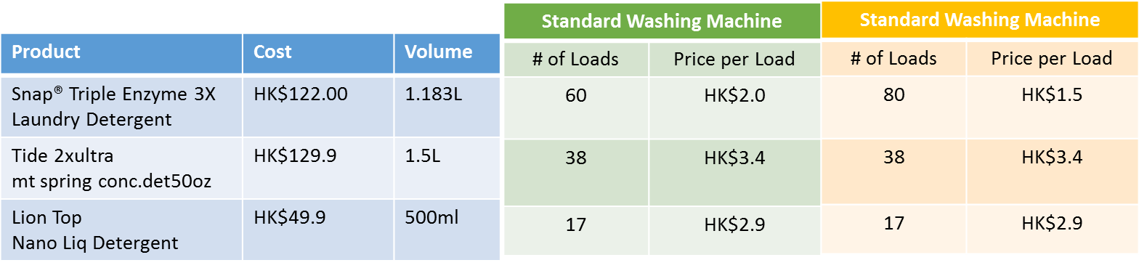
Better Product, Better Price
Notes:
TRAINERS NOTES:
How many people clean their homes?
The SNAP product appears to cost more, but in reality does twice as many loads as the competition.
SNAP is the better product and is almost half the cost of the competition

Slide 23
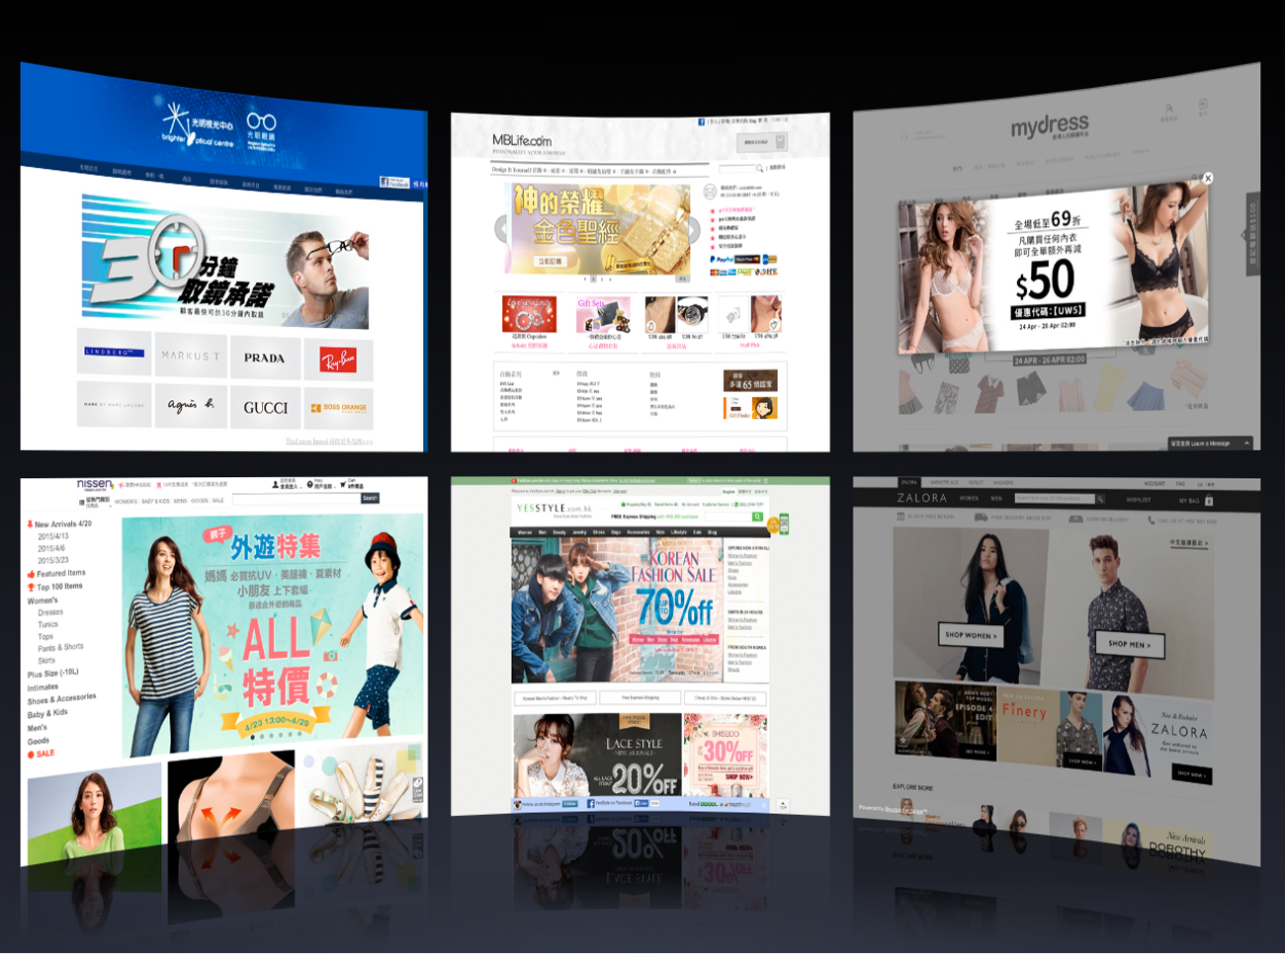
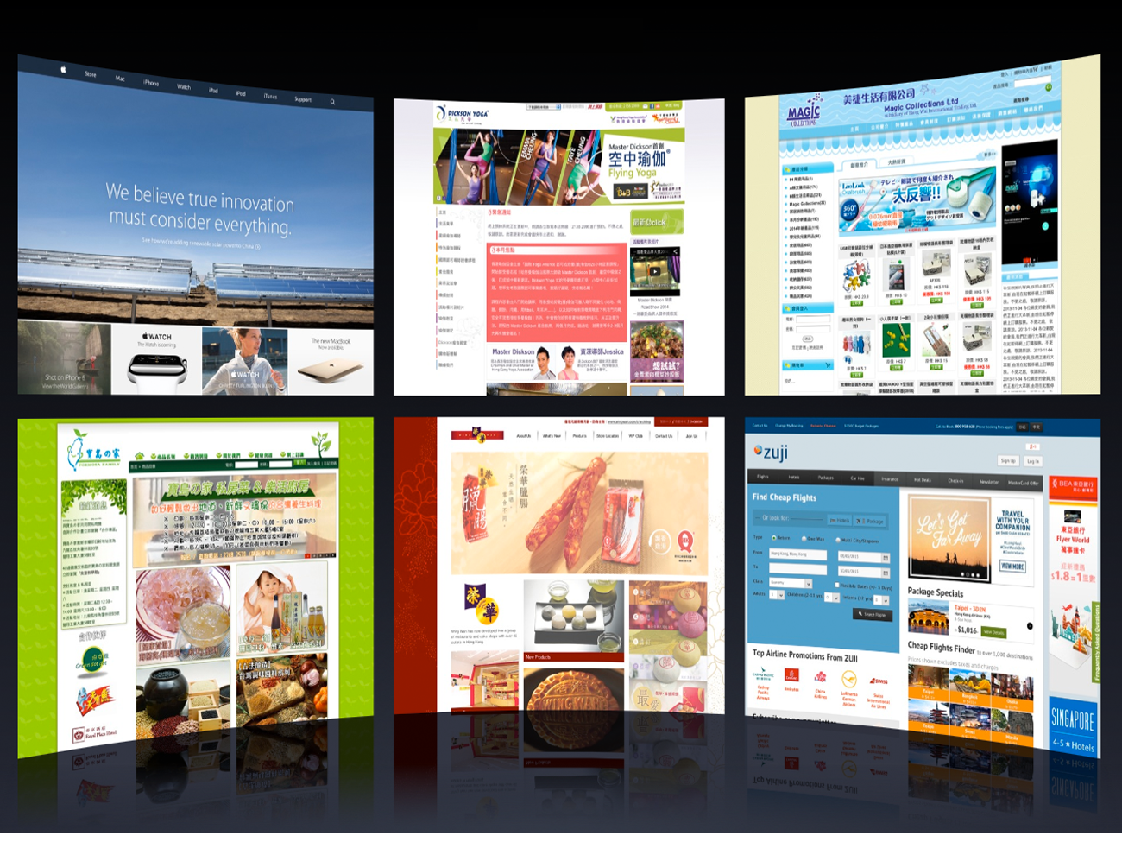
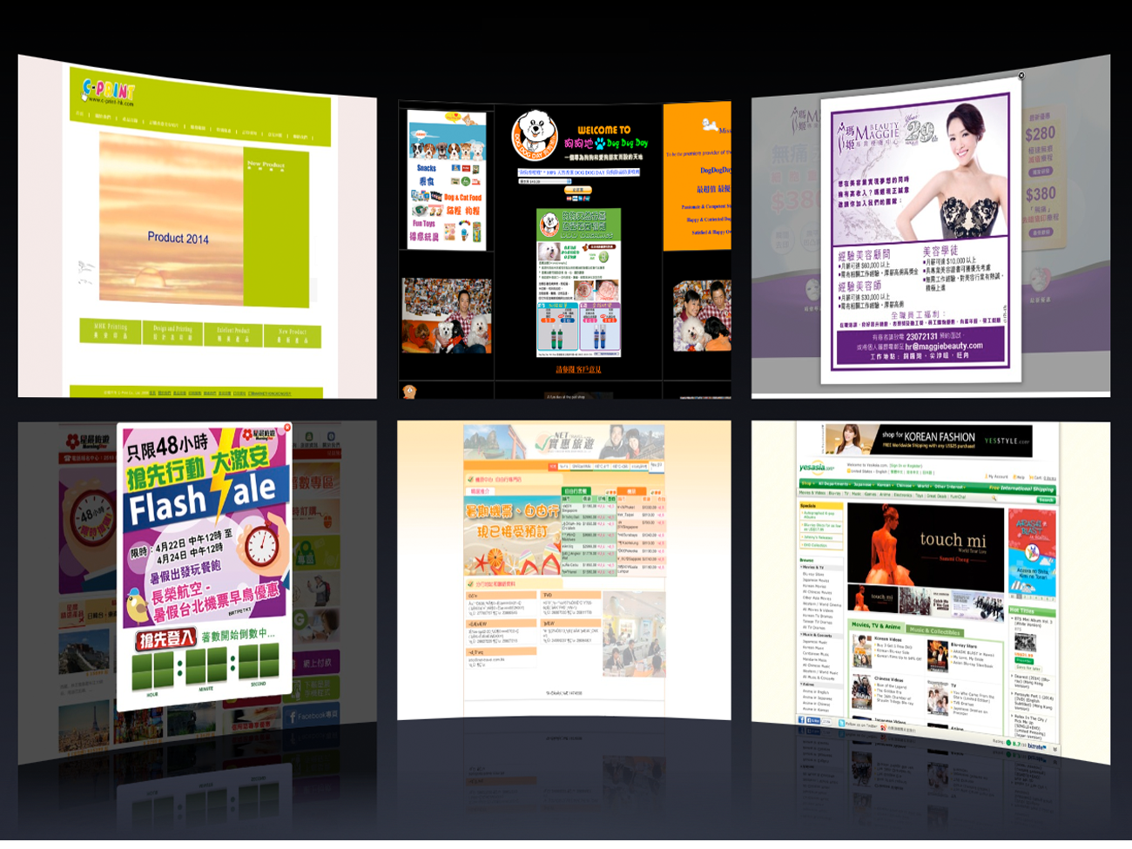
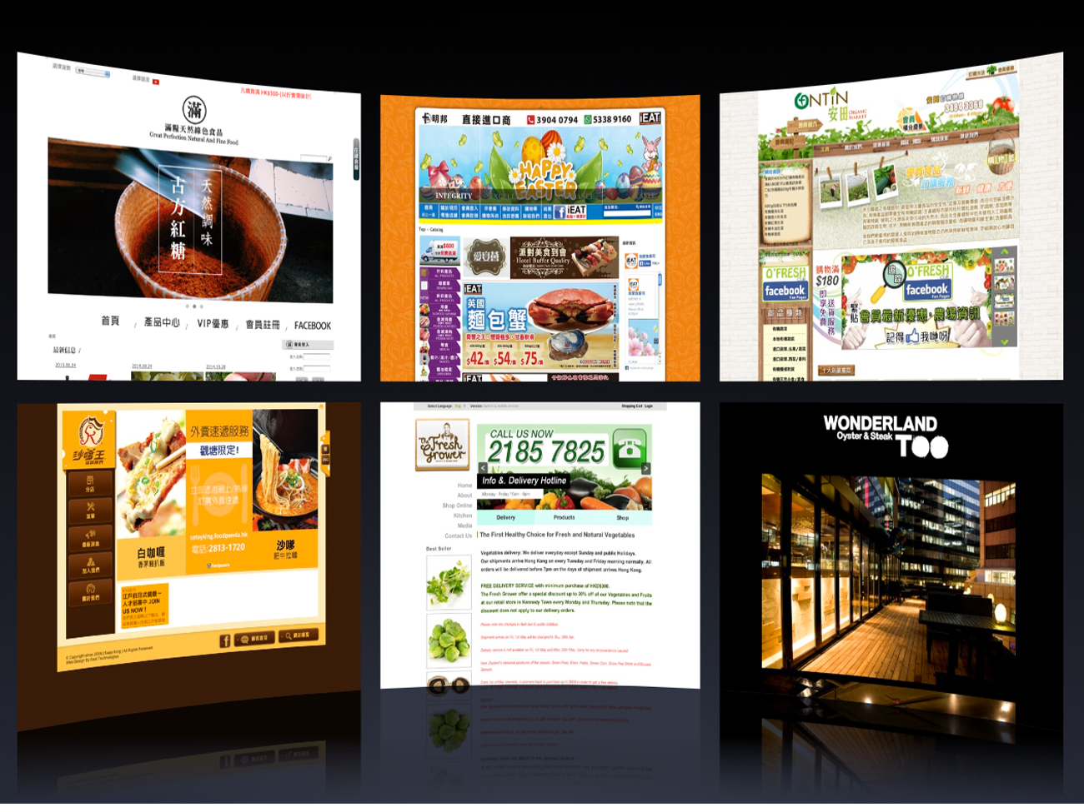
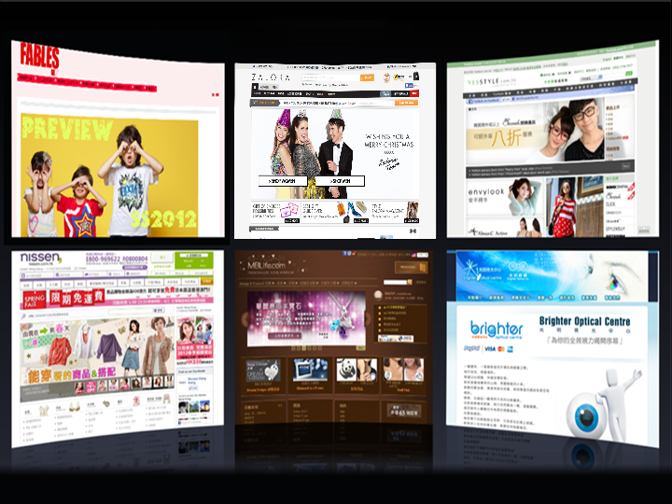
























夥伴商店 Partner Stores
夥伴商店 Partner Stores
夥伴商店 Partner Stores
夥伴商店 Partner Stores

Slide 24
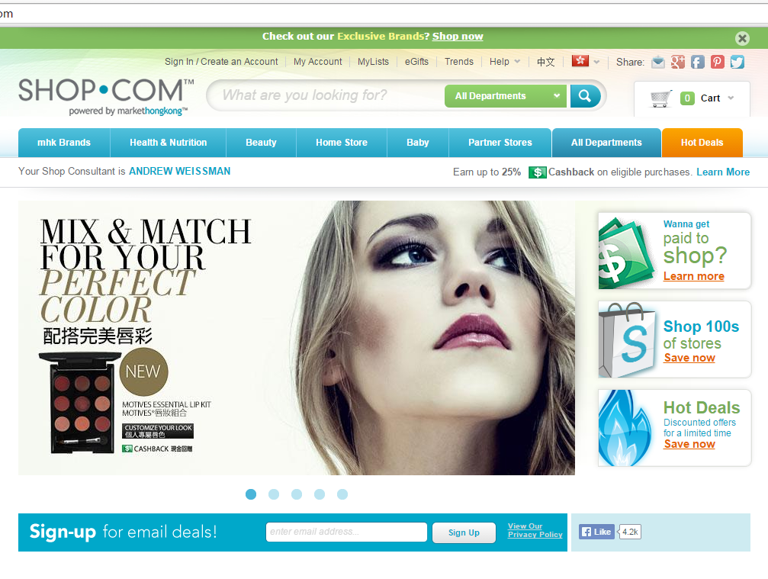
現金回贈Cashback 2-25%
Notes:
TRAINERS NOTES:
We have a CashBack program that pays you and your customers cash back on everything you buy through our site.
This Cashback is credited to you in addition the BV and IBV you earn on your purchases

Slide 25



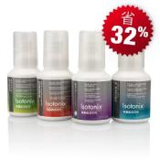






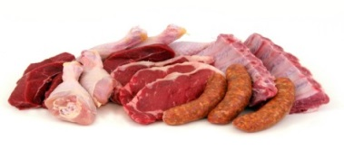
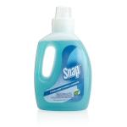
CONVERT SPENDING INTO EARNING
雜項開銷
Miscellaneous
個人保養產品與服務
Personal care products and services
閱讀
Reading
雜項開銷
個人保養產品與服務
雜項開銷
個人保養產品與服務
娛樂
Entertainment
閲讀
娛樂
閲讀
娛樂
健保
Healthcare
食品
Food
健保
健保
食品
食品
為您而設
交通
Transportation
住房
交通
住房
交通
服裝與服務
服裝與服務
服裝與服務
Clothing and services
住房
Housing

Slide 26
你的每月開支與每月平均開支比較，結果如何？
How does your monthly spending compare to the average monthly spending?
稍後，你將會有一個簡單的每月開支和平均開支比較。
Later, you will go through a simple exercise to identify how your monthly spending compares to the average spending.
食物Food
每年回贈Annual Cashback
$300 x 12 = $3600
$750 x 12 = $9000
$1500 x12 = $18000
$2250 x12 = $27000
住屋Housing
服裝與服務Apparel & Service
全年開支Annual Total
$175,044
交通Transportation
健康護理Healthcare
每月回贈Monthly Cashback
$15000 x 2% = $300
$15000 x 5% = $750
$15000 x 10% = $1500
$15000 x 15% = $2250
娛樂Entertainment
每月開支Monthly Total
個人護理產品及服務Personal Care Product & Service
$14,587
閱讀Reading
雜項MISCELLANEOUS
Notes:
Celine:
We need more time to localize slides 13-18 as we are waiting for latest figures from government sources.
TRAINERS NOTES:
There are little pockets of spending everywhere that could be transferred to your Shopping Annuity. You just have to be aware of where your money is going and make a conscious decision to transfer it.
Your business is currently LEAKING MONEY everywhere. You have the opportunity to take all of this money, which statistically you are going to spend anyway and turn that spending into a residual income for yourself.
Ask yourself, how much are you missing out on? If your team is only doing 10% of their shopping on their SHOP.COM website, it’s like taking a pallet of thousands of dollars and just setting it on fire. Money wasted!
Don’t waste or underestimate the power of your current spending. Put that money to work for you and use it to build your Shopping Annuity.

Slide 27

現金回贈 Cashback
……更多
And more…

Slide 28
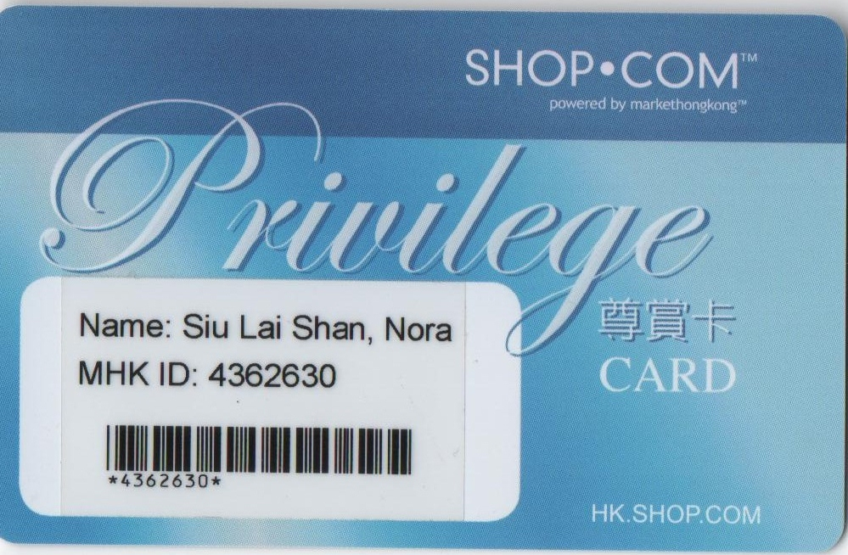

你選擇做那個角色?
Which role do you prefer?
1. 優惠顧客 Preferred Customer
用電郵就可登記 Registration with email
免費有 ‘VIP’顧客卡 FREE VIP Card
網上下消費有 2% - 25%現金回贈($)
On/off-line shopping with 2% - 25%Cashback
累積至 HK$80以上可入回銀行户口
Save in your bank account when reaching
the minimum redemption requirement of HKD$80
亦可當現金買產品 Apply the amount at checkout
2. Shop.com 平台加盟者Shop.com platform franchisees
收入來源有 :Sources of income are:
a. 獨家代理產品的零售利潤 ~ 30% ($) Retail profit of exclusive products ~ 30% ($)
b. 產品量的佣金 (BV) Product commission
c. 夥伴商店的介紹佣金 (IBV) Partner Store referral commission
d. 網上下消費有 2% - 25%現金回贈($)
On/off-line shopping with 2% - 25%Cashback
e. shop.com的廣告收入 (BV, IBV) shop.com advertising revenue

Slide 29
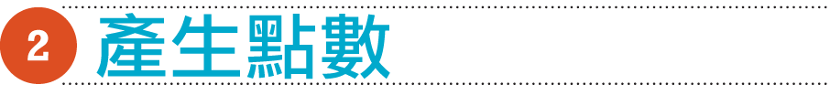











CREATE
BV 業績點數
業績點數(BV)是分派給美安香港
獨家品牌產品的價值單位
IBV 獎勵業績點數
獎勵業績點數(IBV)是每項夥伴商店
商品代表的價值單位
Business volume (BV) is the unit value (points) assigned to exclusive Market Hong Kong - branded products
Incentive Business volume (IBV) is the unit value (points) assigned to any of our Partner Store products

Slide 30

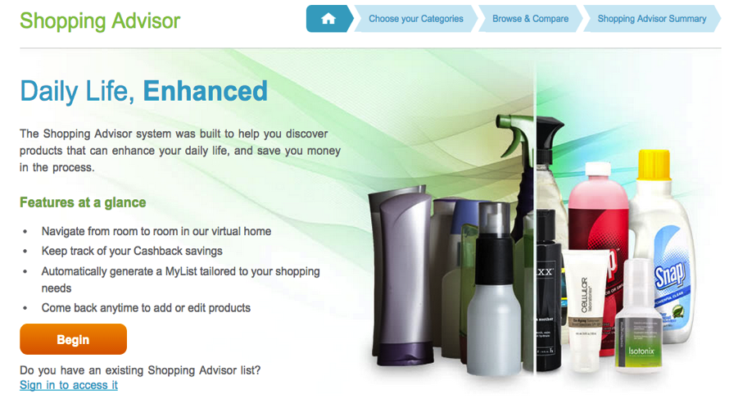
購買 shop.com 品牌創造 BV
Create BV with
OUR Brands
Notes:
TRAINERS NOTES:
Once you’ve seen the potential, you can complete the online Shopping Advisor on SHOP.COM.
This will even create a “My List” for you which will make buying products easier!

Slide 31


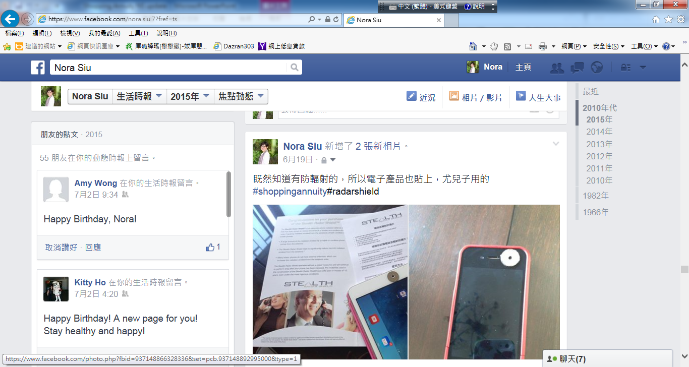
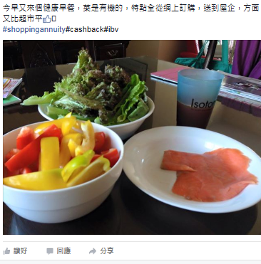
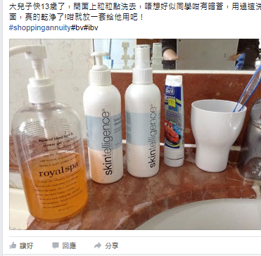


Slide 32

將平時要逛街購買其他品牌和產品Change how you buy all other brands and products directly from other establishments
轉成to
在你的SHOP.COM網站購買﹗
buying them through your own
SHOP.COM website!
夥伴商店創造IBV
Create IBV with
Partner Stores
Notes:
TRAINERS NOTES:
The second step is to identify all of the other places you spend money with other stores and change HOW YOU BUY THEM.
You can’t convert 100% of your buying to our brands, so identify how you can get everything else you need from our partners through SHOP.COM
Again – same products / Same retailers = just shift the behavior to buying it through your SHOP.COM website

Slide 33
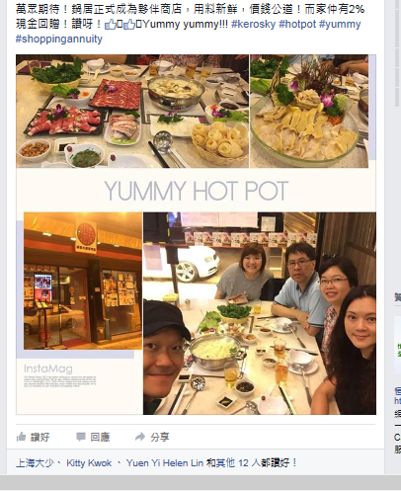

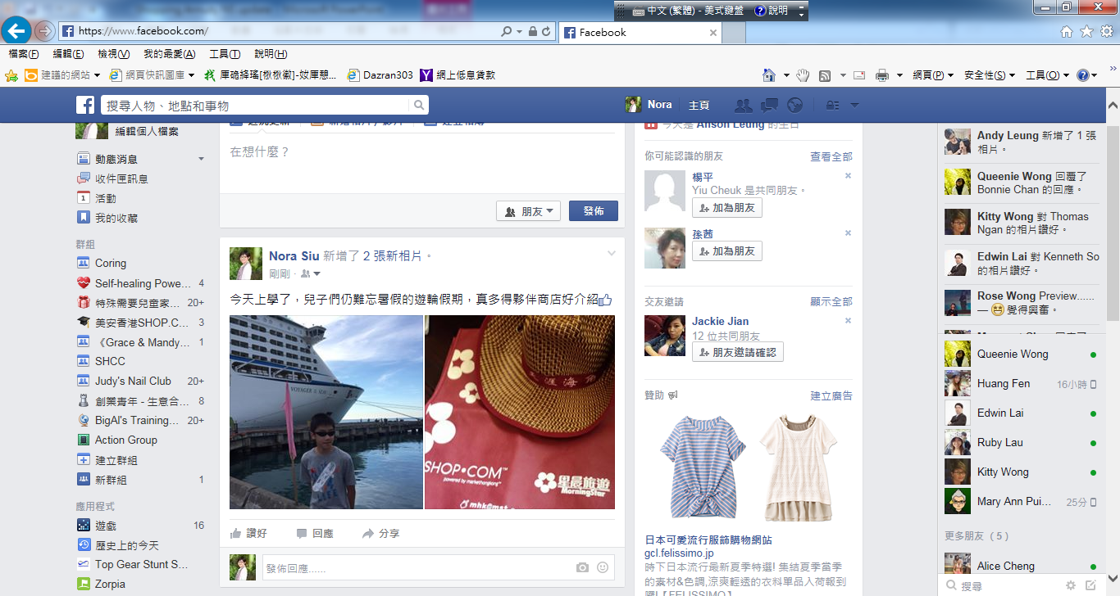

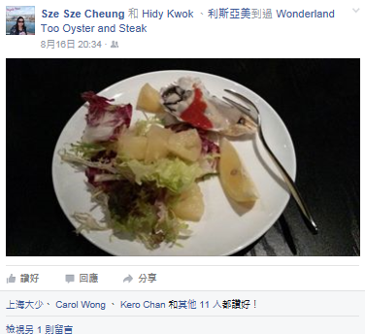

Slide 34
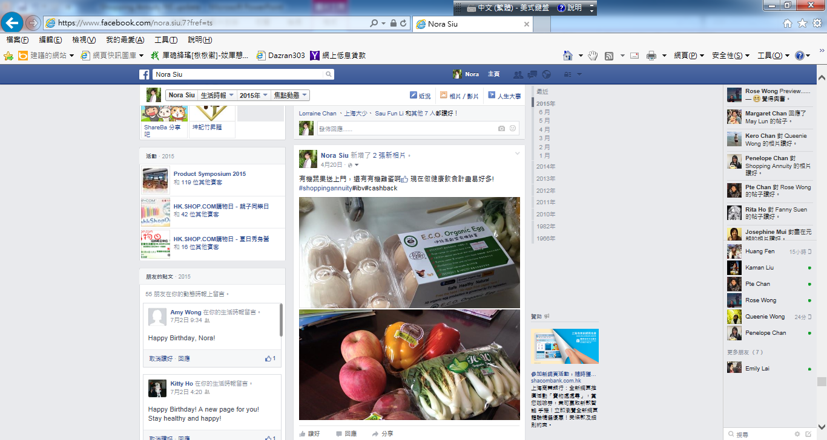
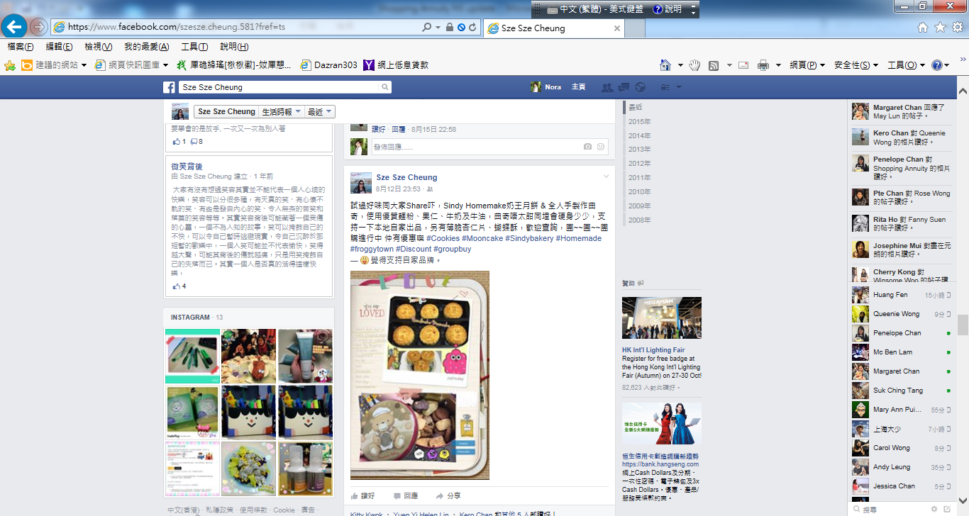




Slide 35
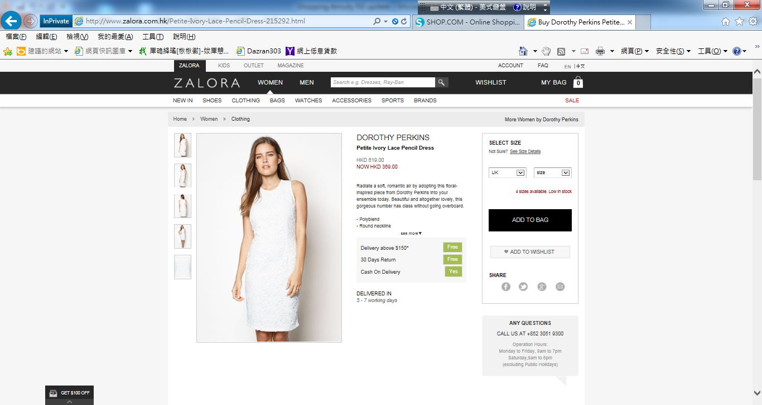

Slide 36

IBV
BV
IBV
BV
BV
IBV

Slide 37
這是你的選擇
It’s Your Choice
你不斷消費使其他人和公司賺錢
You can continue to spend money and make other companies and people money
利用購物年金轉消費為收入及幫自己賺錢You can Convert Your Spending into Earning with the Shopping Annuity and help make yourself money?
或OR
你想要哪一種﹖Which do you Prefer?
Notes:
TRAINERS NOTES:
This is critical! Do not skip through this slide. It’s the equivalent of the the slide in the UBP which asks if they want the 45 year plan or the UnFranchise.
You can continue to spend money you are already spending the way that you’re spending it. This will continue to make money for the companies you purchase from and earn you nothing. Nothing changes! OR
You can convert your spending into earning. Continue to purchase all of the things you are going to purchase anyway and be paid on those margins from your spending as well as the spending of anyone you lead to directly or indirectly.

Slide 38



你選的角色 Your role
2. Shop.com 平台加盟者Shop.com platform franchisees
收入來源有 :Sources of income are:
a. 獨家代理產品的零售利潤 ~ 30% ($) Retail profit of exclusive products ~ 30% ($)
b. 產品量的佣金 (BV) Product commission
c. 夥伴商店的介紹佣金 (IBV) Partner Store referral commission
d. 網上下消費有 2% - 25%現金回贈($)
On/off-line shopping with 2% - 25%Cashback
e. shop.com的廣告收入 (BV, IBV) shop.com advertising revenue

Slide 39

  找出10至15名顧客來改變其消費習慣，以符合步驟1與2的要求，與他們建立夥伴關係(超連鎖™店主)。Identify 10-15 individuals and build relationships to create lifetime value in customers or future business partners (UFOs).
顧客購買美安品牌產品可賺取現金回贈Customers get paid Cashback for purchasing the company’s exclusive brands.
顧客透過你的入門網站到夥伴商店消費可賺取現金回贈Customers get paid Cashback for purchasing from our partner stores through your site.
顧客成為夥伴
Create BV & IBV with
一起創造更多BV和IBV
賺取真正的持續收入
Earn the ongoing income
Customers
Notes:
TRAINERS NOTES:
Don’t forget to build share of customer! You can create additional BV and IBV by creating lifetime value with your customers.

Slide 40
10-15個家庭轉移消費
10-15 families convert their spending
雜項開銷
Miscellaneous
個人保養產品與服務
Personal care products and services
閱讀
Reading
雜項開銷
個人保養產品與服務
雜項開銷
娛樂
Entertainment
個人保養產品與服務
每個家庭每月 $15,000
10 個家庭每月
$15,000 x 10 = $150,000
閲讀
娛樂
閲讀
娛樂
健保
Healthcare
食品
Food
健保
健保
食品
食品
為您而設
交通
Transportation
住房
交通
住房
交通
服裝與服務
服裝與服務
服裝與服務
Clothing and services
住房
Housing

Slide 41
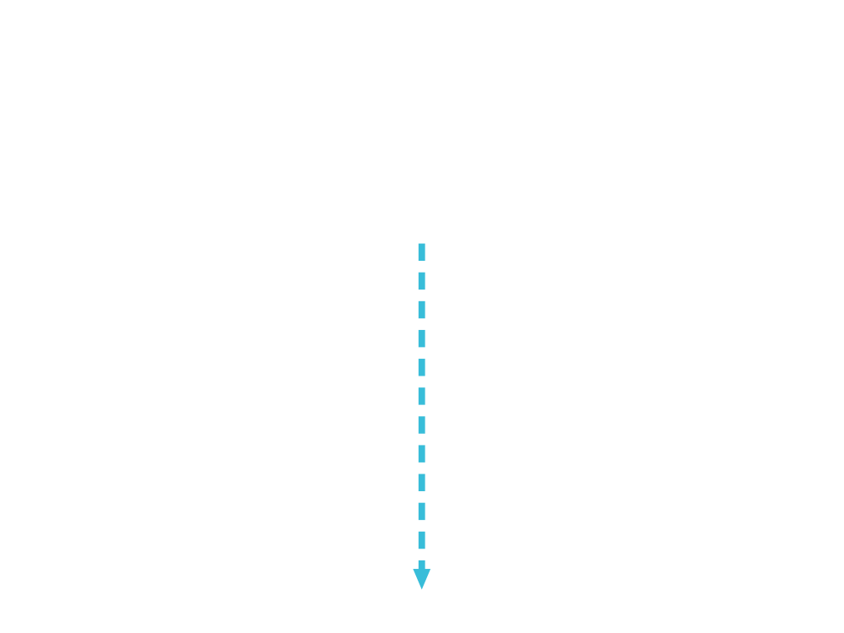
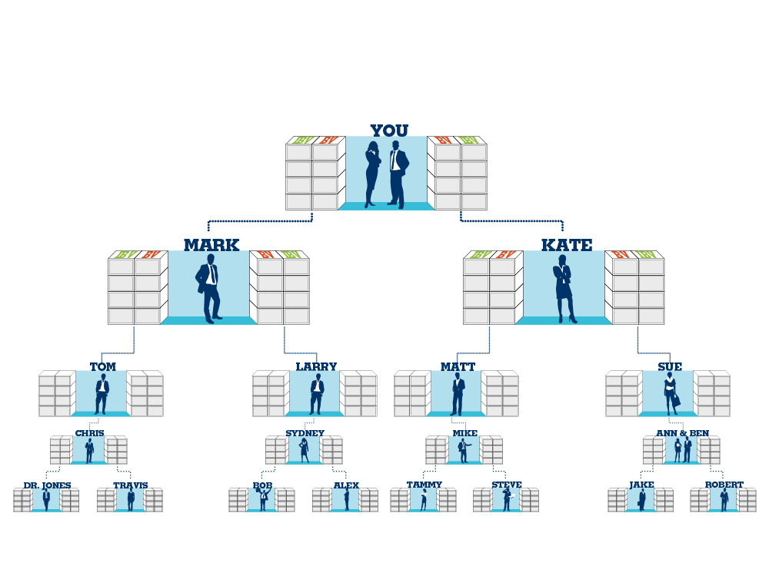

組織達到基本業務要求
$4,600 每月each month (BV) & $2,300 每第三個月every third month (IBV)
50 x 50 BV = 2,500 BV
50 x 10 IBV = 500 IBV
50 x 50 BV = 2,500 BV
50 x 10 IBV = 500 IBV
(50x$600= $30,000)
(50x$120= $7,200)
(50x600= $30,000)
(50x$120= $7,200)
Notes:
TRAINERS NOTES:
This is an organization of 50 people on the left and 50 people on the right
Everyone is doing the minimum activity requirements / not participating in the Shopping Annuity
The multiplier is small because noone is really doing the business and definitely not doing the shopping annuity , therefore only creating $600 per month in BV checks and $300 every 3 months in IBV commissions.

Slide 42
組織達到基本業務要求
$4,600 每月each month (BV) & $2,300 每第三個月every third month (IBV)
50 x 50 BV = 2,500 BV
50 x 10 IBV = 500 IBV
50 x 50 BV = 2,500 BV
50 x 10 IBV = 500 IBV
(50x$600= $30,000)
(50x$120= $7,200)
(50x$600= $30,000)
(50x$120= $7,200)
Notes:
TRAINERS NOTES:
This is an organization of 50 people on the left and 50 people on the right
Everyone is doing the minimum activity requirements / not participating in the Shopping Annuity
The multiplier is small because noone is really doing the business and definitely not doing the shopping annuity , therefore only creating $600 per month in BV checks and $300 every 3 months in IBV commissions.

Slide 43
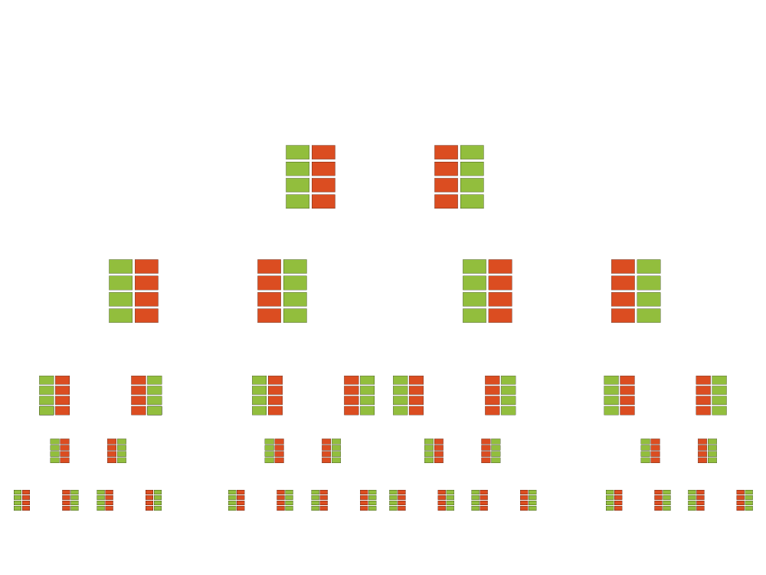
組織達到一起建立購物年金
$57,500 每月each month (BV) & $23,000 每月each month (IBV)
50 x 500 BV = 25,000BV
50 x 200 IBV =10,000 IBV
50 x 500 BV = 25,000 BV
50 x 200 IBV =10,000 IBV
(50x$6000= $300,000)
(50x$2200= $120,000)
(50x$6000= $300,000)
(50x$2200= $120,000)
Notes:
TRAINERS NOTES:
Look at the incredible difference when you take that exact same organization and have everyone doing the Shopping Annuity
The SA is the forced multiplier!
With everyone committing to the Shopping Annuity, that same organization is creating a way more substantial income for your business… $7,500/month in BV commissions and $3,000/month in IBV Commissions.

Slide 44

把你的日常消費成為投資本金建立屬於自己的購物年金Create your “Fixed Sum” Payment using your current spending to create a residual income for yourself
慳錢Save Money
賺錢Earn Money
購物年金創造
The Shopping Annuity Creates
經濟動力Economic Synergy
把過程在你的團隊和顧客間複製
以增加和累積你的購物年金﹗
Duplicate the process with your organization & customers to accelerate and increase residual income!
Notes:
TRAINERS NOTES:
This is another slide to bring the big point Home!
It’s a summary slide that shows the power of the Shopping Annuity
This is a transition to illustrate exactly why it works and how it works

Slide 45

Shop.com

Slide 46
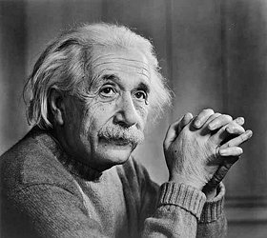


Slide 47


Slide 48
購物年金
Shopping Annuity
打造超連鎖事業
Grow your Unfranchise business
Notes:
TRAINERS NOTES:
Welcome guests. Let them know that why you’re excited to be sharing this revolutionary concept with them.
It gives everyone a chance to enjoy the benefits of annuity without having to fund it with discretionary income, but rather with money they are already spending
We are going to show you how you could create a residual income for yourself by simply changing how you shop and duplicating it with your team
This plan is essentially rocket fuel for the MPCP.
Share any of your personal success or team’s success with the Shopping Annuity

Slide 49

2015 美安香港成功領袖會議
MHK Leadership Conference 2015

